Slide 1
Master’s degree in Computational Social Sciences 2024-2025
Master Thesis
Modeling perceived urban insecurity: an empirically grounded agent-based simulation
Sara Cristina Herranz Amado
Supervisor:
Iñaki Úcar Marqués
Madrid, June 19th, 2025

Slide 2
WHY URBAN INSECURITY PERCEPTION?
Traditional methods are static tools:
Miss everyday dynamics of fear
Ignore interaction with routines & space
Perceived insecurity goes beyond crime stats:
shaped by spatial cues, symbolic meanings & social dynamics.
Fearscapes (Pain, 1997):
Poor lighting, visible disorder, harassment →
Avoidance behaviours & social fragmentation.
Notes:
Builds on feminist & critical geography insights

Slide 3
WHY URBAN INSECURITY PERCEPTION?
WHY USING ABM?
Traditional methods (crime stats, victimization surveys) are static tools:
Miss everyday dynamics of fear
Ignore interaction with routines & space
Perceived insecurity goes beyond crime stats:
shaped by spatial cues, symbolic meanings & social dynamics.
Fearscapes (Pain, 1997):
Poor lighting, visible disorder, harassment →
Avoidance behaviours & social fragmentation.
Simulate complex, emergent patterns from interactions between people & places
Incorporate diverse agent behaviors
Exploration & testing tool
Try “what-if” scenarios (lighting, youth, routines)
Anticipate effects of interventions (Izquierdo et al., 2020)
To capture the lived, relational nature of insecurity to move beyond crime data and reflect embodied fear
Notes:
Builds on feminist & critical geography insights

Slide 4
AIM & OBJECTIVES
Main purpose
Develop a simulation-based methodology to explore and test perceived urban insecurity scenarios from a spatial and data-driven perspective, for research and policy planning purposes

Slide 5
AIM & OBJECTIVES
Objective by area
Main purpose
Theoretical & Conceptual
Rethink insecurity as relational, contextual and stratified
Develop a simulation-based methodology to explore and test perceived urban insecurity scenarios from a spatial and data-driven perspective, for research and policy planning purposes

Slide 6
AIM & OBJECTIVES
Objective by area
Main purpose
Theoretical & Conceptual
Rethink insecurity as relational, contextual and stratified
Develop a simulation-based methodology to explore and test perceived urban insecurity scenarios from a spatial and data-driven perspective, for research and policy planning purposes
Empirical Grounding
Calibrate the model with survey-based and GIS data

Slide 7
AIM & OBJECTIVES
Objective by area
Main purpose
Theoretical & Conceptual
Rethink insecurity as relational, contextual and stratified
Develop a simulation-based methodology to explore and test perceived urban insecurity scenarios from a spatial and data-driven perspective, for research and policy planning purposes
Empirical Grounding
Calibrate the model with survey-based data and GIS data
Validation & Analysis
Assess model robustness via replication and OAT sensitivity analysis
Explore gendered and exposure-based variability

Slide 8
AIM & OBJECTIVES
Objective by area
Main purpose
Theoretical & Conceptual
Rethink insecurity as relational, contextual and stratified
Develop a simulation-based methodology to explore and test perceived urban insecurity scenarios from a spatial and data-driven perspective, for research and policy planning purposes
Empirical Grounding
Calibrate the model with survey-based and GIS data
Validation & Analysis
Assess model robustness via replication and OAT sensitivity analysis
Explore gendered and exposure-based variability
Applicability
Provide a flexible tool to test scenarios for researchers and policymakers

Slide 9
PAMPLONA AS A CASE STUDY
Recent survey data (2023) on perceived insecurity
Psycosocial variables (relevant according to literature review)
Availability of crime data

Slide 10
(
SIMULATION DESIGN (GAMA)
INPUT DATA
EMPIRICAL MODELING (R)
.shp from Pamplona City Council and Open Street Maps
lightning_score
barrio
building
road
parks
Environment
Balance de Criminalidad Q4 2024
Ministry of Interior
real_crime_proxy
Objective data (Penal Code sentencing + frequency)
Public perception on most and least safe neighborhood
*

Slide 11
(
SIMULATION DESIGN (GAMA)
INPUT DATA
EMPIRICAL MODELING (R)
.shp from Pamplona City Council and Open Street Maps
lightning_score
barrio
building
road
parks
Environment
Balance de Criminalidad Q4 2024
Ministry of Interior
real_crime_proxy
Objective data (Penal Code sentencing + frequency)
Public perception on most and least safe neighborhood
*
Pamplona Survey Data (2023)
Multivariate Linear Regression
CATPCA
Agents

Slide 12
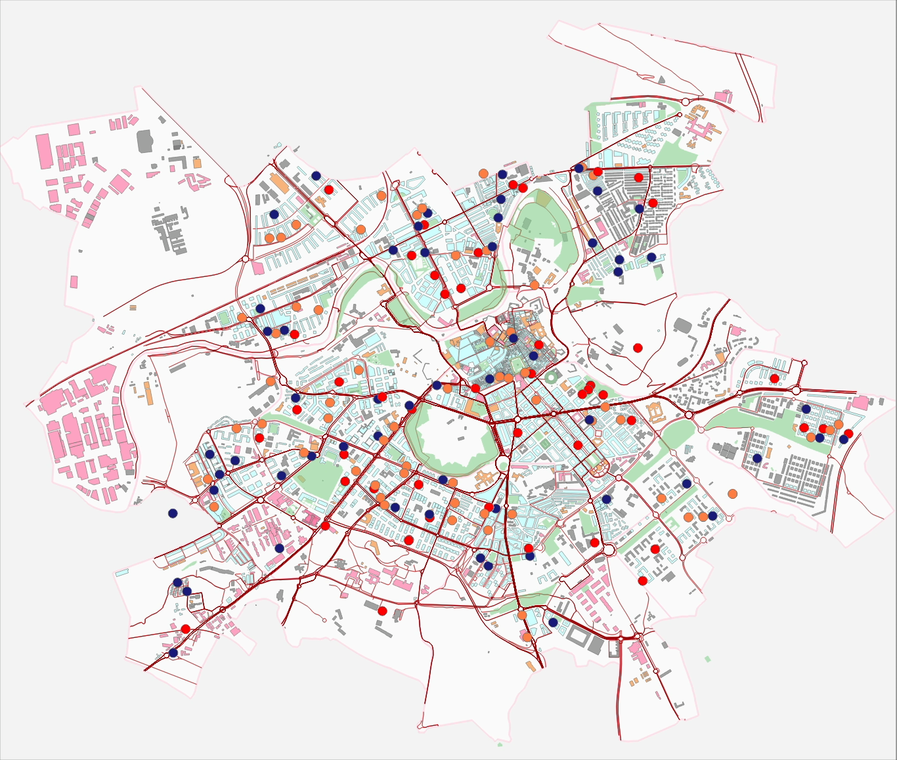

Slide 13
prediction: linear combination
gen_ins
individual effects: gender, nationality, past victimization
social exposure: proximity to visible botellonero
contextual modifier (only at night):
real_crime_proxy * crime_weight
darkness * lightning_score

Slide 14
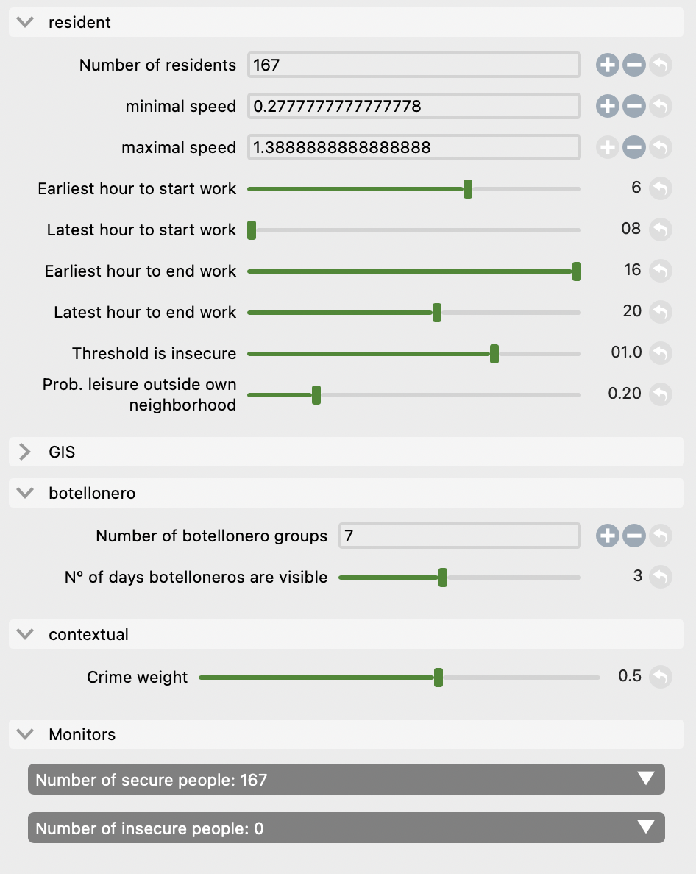

Slide 15
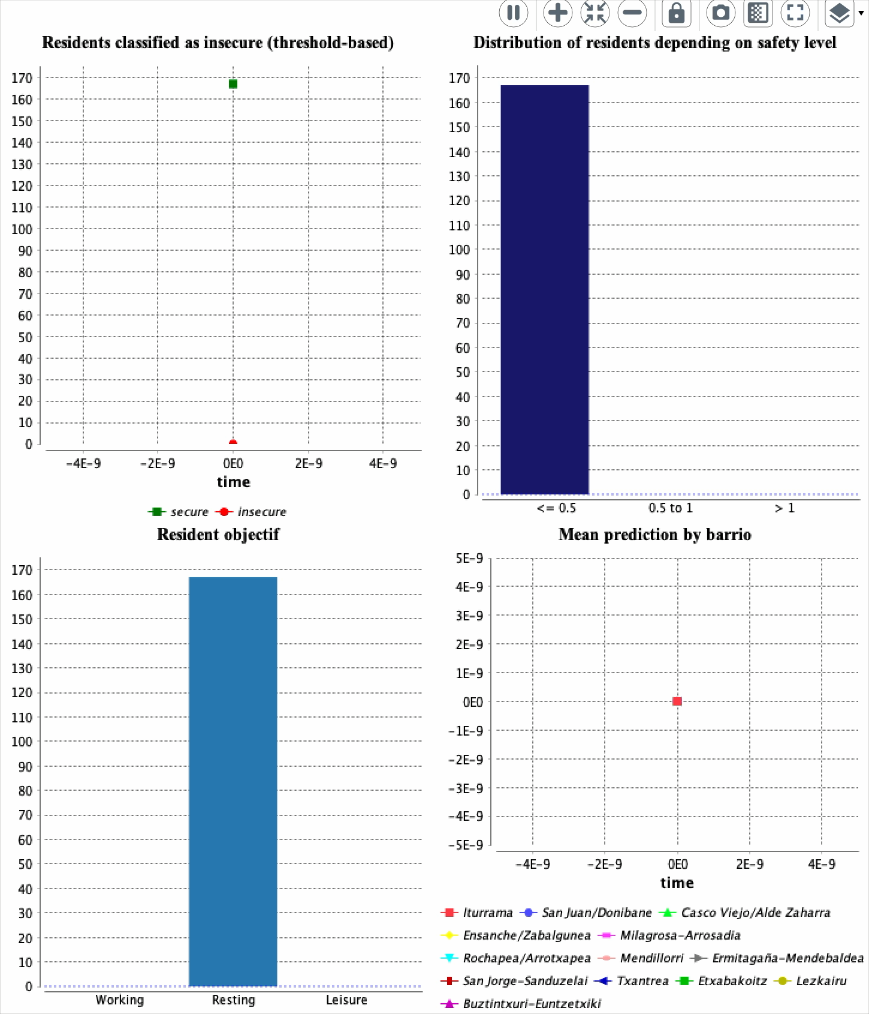

Slide 16
SIMULATIONS FOR DECISION-MAKING (I)
It's Friday night. Small groups of young people gather around different squares.
At first, people pass by without issue, but for some residents this triggers discomfort.
The city wonders: are these feelings of fear significant enough to plan around?

Slide 17
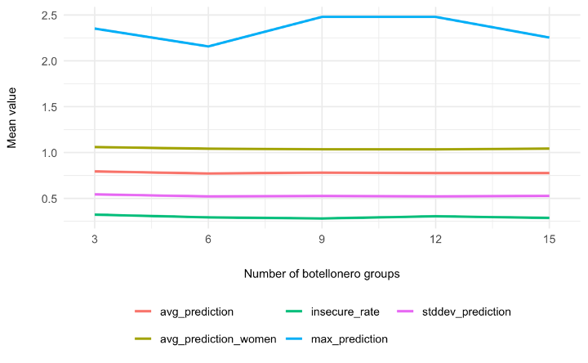
SIMULATIONS FOR DECISION MAKING (I)

Slide 18
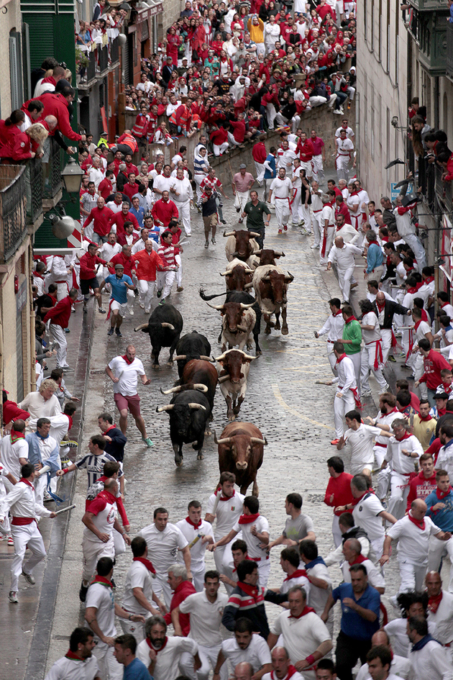
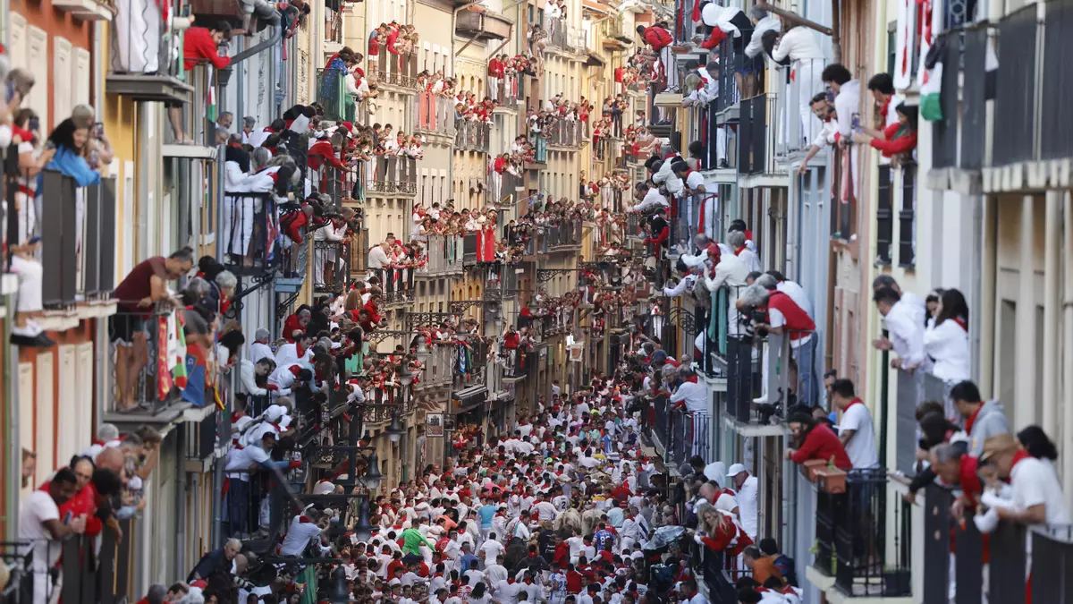
SIMULATIONS FOR DECISION-MAKING (II)
SANFERMINES

Slide 19
SIMULATIONS FOR DECISION-MAKING (II): SANFERMINES
Shift in urban dynamics
Disrupts everyday routines & exposure patterns
Alters symbolic meaning and perceived safety of public space
Policy question: for whom does insecurity increase?

Slide 20
SIMULATIONS FOR DECISION-MAKING (II): SANFERMINES
Shift in urban dynamics
Disrupts everyday routines & exposure patterns
Alters symbolic meaning and perceived safety of public space
Policy question: for whom does insecurity increase?
What would be needed?
Adjust leisure & mobility parameters
Model temporary urban layouts
Include crowding and time-specific risks

Slide 21
TO SUM UP...
MODEL CONTRIBUTIONS
Challenges purely criminological approaches of insecurity
Improves on prior models (e.g., Izquierdo et al., 2020):
Adds agent heterogeneity (gender, vulnerability, nationality)
Includes temporal context
Demonstrates internal coherence, empirical plausibility, and theoretical consistency
Notes:
esto va mejor en la presentación de gama como tal. after presenting the model and its components add something such as: this allows to capture the relational nature of insecurity, to move beyond criminal data etc.

Slide 22
FUTURE IMPROVEMENTS
However, there are some LIMITATIONS
that can be ASSESSED with
Robust global sensitivity analysis methods, such as Sobol indices or Latin Hypercube Sampling.
No interaction effects between different variables
Circularity in crime parameters
Georeferenced crime incidents data
Feedback mechanisms (agents modify their behavior based on prior experiences)
Fixed routines and lack of capacity for adaptation or learning
Notes:
esto va mejor en la presentación de gama como tal. after presenting the model and its components add something such as: this allows to capture the relational nature of insecurity, to move beyond criminal data etc.

Slide 23
THANK YOU VERY MUCH FOR YOUR ATTENTION
Questions or comments are welcomed!

